Slide 1



Mining Frequent Itemsets from Uncertain Data
Chun-Kit Chui [1], Ben Kao [1] and Edward Hung [2]
[1] Department of Computer Science
The University of Hong Kong.
[2] Department of Computing
Hong Kong Polytechnic University
Presenter : Chun-Kit Chui

Slide 2
Presentation Outline
Introduction
  Existential uncertain data model
Possible world interpretation of existential uncertain data
The U-Apriori algorithm
Data trimming framework
Experimental results and discussions
Conclusion

Slide 3
Introduction
Existential Uncertain Data Model

Slide 4



Introduction
Traditional Transaction Dataset
Psychological Symptoms Dataset
 | Mood Disorder | Anxiety Disorder | Eating Disorder | Obsessive-Compulsive Disorder | Depression | … | Self Destructive Disorder
 |  |  |  |  |  | …
 |  |  |  |  |  | …
…
Patient 1
Patient 2
The psychologists maybe interested to find the following associations between different psychological symptoms.
Mood disorder => Eating disorder
These associations are very useful information to assist diagnosis and give treatments.
Eating disorder => Depression + Mood disorder
Mining frequent itemsets is an essential step in association analysis.
  E.g. Return all itemsets that exist in s% or more of the transactions in the dataset.
In traditional transaction dataset, whether an item “exists” in a transaction is well-defined.

Slide 5
Introduction
Existential Uncertain Dataset
Psychological Symptoms Dataset
 | Mood Disorder | Anxiety Disorder | Eating Disorder | Obsessive-Compulsive Disorder | Depression | … | Self Destructive Disorder
 |  |  |  |  |  | …
 |  |  |  |  |  | …
…
Patient 1
97%
5%
84%
14%
76%
9%
Patient 2
90%
85%
100%
86%
65%
48%
In many applications, the existence of an item in a transaction is best captured by a likelihood measure or a probability.
  Symptoms, being subjective observations, would best be represented by probabilities that indicate their presence.
  The likelihood of presence of each symptom is represented in terms of existential probabilities.
What is the definition of support in uncertain dataset?

Slide 6

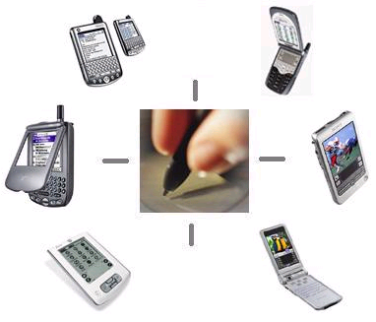
Existential Uncertain Dataset
Existential Uncertain Dataset
 | Item 1 | Item 2 | …
Transaction 1 | 90% | 85% | …
Transaction 2 | 60% | 5% | …
…
An existential uncertain dataset is a transaction dataset in which each item is associated with an existential probability indicating the probability that the item “exists” in the transaction.
Other applications of existential uncertain datasets
  Handwriting recognition, Speech recognition
  Scientific Datasets

Slide 7
Possible World Interpretation
The definition of frequency measure in existential uncertain dataset
by S. Abiteboul in the paper “On the Representation and Querying of Sets of Possible Worlds“ in SIGMOD 1987.

Slide 8
Possible World Interpretation
Psychological symptoms dataset
Example
  A dataset with two psychological symptoms and two patients.
  16 Possible Worlds in total.
  The support counts of itemsets are well defined in each individual world.
 | Depression | Eating Disorder
Patient 1 | 90% | 80%
Patient 2 | 40% | 70%
1 | S1 | S2
P1 | √ | √
P2 | √ | √
2 | S1 | S2
P1 | × | √
P2 | √ | √
3 | S1 | S2
P1 | √ | ×
P2 | √ | √
From the dataset, one possibility is that both patients are actually having both psychological illnesses.
4 | S1 | S2
P1 | √ | √
P2 | × | √
5 | S1 | S2
P1 | √ | √
P2 | √ | ×
6 | S1 | S2
P1 | √ | √
P2 | × | ×
On the other hand, the uncertain dataset also captures the possibility that patient 1 only has eating disorder illness while patient 2 has both of the illnesses.
7 | S1 | S2
P1 | × | ×
P2 | √ | √
8 | S1 | S2
P1 | √ | ×
P2 | √ | ×
9 | S1 | S2
P1 | × | √
P2 | × | √
10 | S1 | S2
P1 | × | √
P2 | √ | ×
11 | S1 | S2
P1 | √ | ×
P2 | × | √
12 | S1 | S2
P1 | √ | ×
P2 | × | ×
13 | S1 | S2
P1 | × | √
P2 | × | ×
14 | S1 | S2
P1 | × | ×
P2 | √ | ×
15 | S1 | S2
P1 | × | ×
P2 | × | √
16 | S1 | S2
P1 | × | ×
P2 | × | ×

Slide 9
Possible World Interpretation
Psychological symptoms dataset
Support of itemset {Depression,Eating Disorder}
 | Depression | Eating Disorder
Patient 1 | 90% | 80%
Patient 2 | 40% | 70%
World Di | Support {S1,S2} | World Likelihood
1
2
3
4
5
6
7
8
… |  | …
2
0.9 × 0.8 × 0.4 × 0.7
0.2016
1
0.0224
1 | S1 | S2
P1 | √ | √
P2 | √ | √
2 | S1 | S2
P1 | × | √
P2 | √ | √
3 | S1 | S2
P1 | √ | ×
P2 | √ | √
1
0.0504
1
0.3024
1
0.0864
1
0.1296
4 | S1 | S2
P1 | √ | √
P2 | × | √
5 | S1 | S2
P1 | √ | √
P2 | √ | ×
6 | S1 | S2
P1 | √ | √
P2 | × | ×
1
0.0056
0
0.0336
  We can also discuss the likelihood of possible world 1 being the true world.
0
  We can discuss the support count of itemset {S1,S2} in possible world 1.
7 | S1 | S2
P1 | × | ×
P2 | √ | √
8 | S1 | S2
P1 | √ | ×
P2 | √ | ×
9 | S1 | S2
P1 | × | √
P2 | × | √
10 | S1 | S2
P1 | × | √
P2 | √ | ×
11 | S1 | S2
P1 | √ | ×
P2 | × | √
  We define the expected support being the weighted average of the support counts represented by ALL the possible worlds.
12 | S1 | S2
P1 | √ | ×
P2 | × | ×
13 | S1 | S2
P1 | × | √
P2 | × | ×
14 | S1 | S2
P1 | × | ×
P2 | √ | ×
15 | S1 | S2
P1 | × | ×
P2 | × | √
16 | S1 | S2
P1 | × | ×
P2 | × | ×

Slide 10

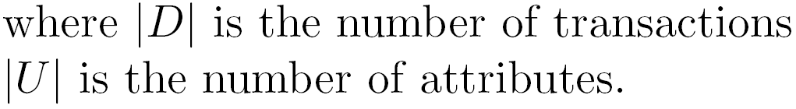
Possible World Interpretation
World Di | Support {S1,S2} | World Likelihood
1
2
3
4
5
6
7
8
… |  | …
Weighted Support
0.4032
0.0224
0.0504
0.3024
0.0864
0.1296
0.0056
0
0
2
0.2016
1
0.0224
1
0.0504
1
0.3024
  Expected Support is calculated by summing up the weighted support counts of ALL the possible worlds.
1
0.0864
1
0.1296
1
0.0056
0
0.0336
0
Expected Support | 1
  We define the expected support being the weighted average of the support counts represented by ALL the possible worlds.
  We expect there will be 1 patient has both “Eating Disorder” and “Depression”.
  To calculate the expected support, we need to consider all possible worlds and obtain the weighted support in each of the enumerated possible world.

Slide 11
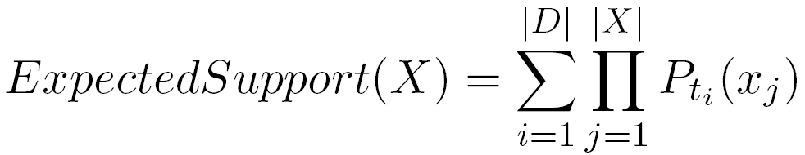
Possible World Interpretation
Instead of enumerating all “Possible Worlds” to calculate the expected support, it can be calculated by scanning the uncertain dataset once only.
where Pti(xj) is the existential probability of item xj in transaction ti.
Psychological symptoms database
The expected support of {S1,S2} can be calculated by simply multiplying the existential probabilities within the transaction and obtain the total sum of all transactions.
 | S1 | S2
Patient 1 | 90% | 80%
Patient 2 | 40% | 70%
Weighted Support of {S1,S2}
0.72
0.28
Expected Support of {S1,S2} | 1

Slide 12
Mining Frequent Itemsets from Uncertain Data
Problem Definition
  Given an existential uncertain dataset D with each item of a transaction associated with an existential probability, and a user-specified support threshold s, return ALL the itemsets having expected support greater than or equal to |D|× s.

Slide 13
Mining Frequent Itemsets from Uncertain Data
The U-Apriori algorithm

Slide 14
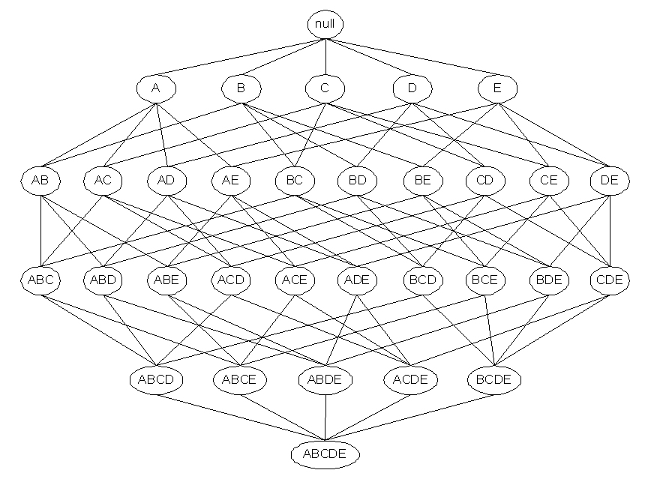
The Apriori Algorithm
The Subset Function scans the dataset once and obtain the support counts of ALL size-1-candidates.
Subset Function
Item {A} is infrequent, by the Apriori Property, ALL supersets of {A} must NOT be frequent.
The Apriori-Gen procedure generates ONLY those size-(k+1)-candidates which are potentially frequent.
The Apriori algorithm starts from inspecting ALL size-1 items.
Candidates
Large itemsets
{BC}
{BD}
{BE}
{CD}
{CE}
{DE}
X
{A}
{B}
{C}
{D}
{E}
{B}
{C}
{D}
{E}
X
X
X
X
X
X
X
X
X
X
X
X
X
X
Apriori-Gen
X

Slide 15
The Apriori Algorithm
Subset Function
The algorithm iteratively prunes and verifies the candidates, until no candidates are generated.
Candidates
Large itemsets
{BC}
{BD}
{BE}
{CD}
{CE}
{DE}
{B}
{C}
{D}
{E}
X
X
X
X
X
X
X
X
X
X
X
X
X
X
X
X
X
X
X
X
X
Apriori-Gen
X

Slide 16
The Apriori Algorithm
Subset Function
The Subset-Function reads the dataset transaction by transaction to update the support counts of the candidates.
Candidates
Large itemsets
Apriori-Gen
Transaction 1
1 (90%) | 2 (80%) | 4 (5%) | 5 (60%) | 8 (0.2%) | 991 (95%)
Recall that in Uncertain Dataset, each item is associated with an existential probability.
Level 0
Level 1
Hash table
Expected Support Count
Candidate Itemset | Support Count
{1,2} | 0
{1,5} | 0
{1,8} | 0
{4,5} | 0
{4,8} | 0
1,4,7
2,5,8
3,6,9

Slide 17
The Apriori Algorithm
Subset Function
Candidates
Large itemsets
Apriori-Gen
Transaction 1
1 (90%) | 2 (80%) | 4 (5%) | 5 (60%) | 8 (0.2%) | 991 (95%)
The expected support of {1,2} contributed by transaction 1 is 0.9*0.8 = 0.72.
Level 0
Level 1
Hash table
Expected Support Count
Candidate Itemset
{1,2} | 0
{1,5} | 0
{1,8} | 0
{4,5} | 0
{4,8} | 0
We call this minor modified algorithm the U-Apriori algorithm, which serves as the brute-force approach of mining the uncertain datasets.
0.72
0.54
0.0018
1,4,7
2,5,8
3,6,9
0.03
0.0001

Slide 18
The Apriori Algorithm
Subset Function
Candidates
Large itemsets
Apriori-Gen
Transaction 1
1 (90%) | 2 (80%) | 4 (5%) | 5 (60%) | 8 (0.2%) | 991 (95%)
Many insignificant support increments. If {4,8} is an infrequent itemsets, all the resources spent on these insignificant support increments are wasted.
Level 0
Level 1
Hash table
Expected Support Count
Candidate Itemset
{1,2} | 0
{1,5} | 0
{1,8} | 0
{4,5} | 0
{4,8} | 0
We call this minor modified algorithm the U-Apriori algorithm, which serves as the brute-force approach of mining the uncertain datasets.
0.72
0.54
0.0018
1,4,7
2,5,8
3,6,9
0.03
0.0001

Slide 19
Computational Issue
Preliminary experiment to verify the computational bottleneck of mining uncertain datasets.
  7 synthetic datasets with same frequent itemsets.
  Vary the percentages of items with low existential probability (R) in the datasets.
1
2
3
4
5
6
7
0%
33.33%
50%
60%
66.67%
71.4%
75%

Slide 20
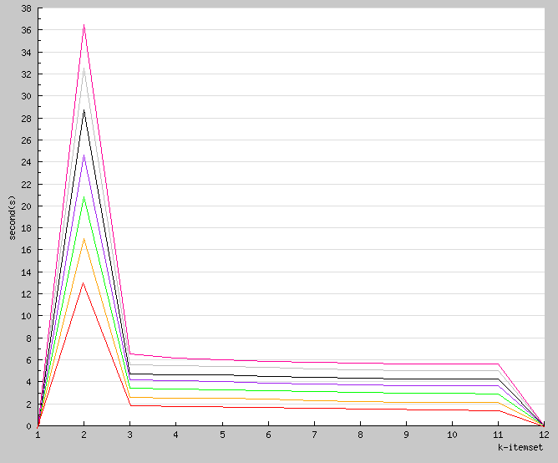
Computational Issue
CPU cost in each iteration of different datasets
Fraction of items with low existential probability : 75%
The dataset with 75% low probability items has many insignificant support increments. Those insignificant support increments maybe redundant.
7
75%
This gap can potentially be reduced.
Fraction of items with low existential probability : 0%
1
0%
Although all datasets contain the same frequent itemsets, U-Apriori requires different amount of time to execute.
Iterations

Slide 21
Data Trimming Framework
Avoid incrementing those insignificant expected support counts.

Slide 22
Data Trimming Framework
Direction
  Try to avoid incrementing those insignificant expected support counts.
  Save the effort for
    Traversing the hash tree.
    Computing the expected support count. (Multiplication of float variables)
    The I/O for retrieving the items with very low existential probability.

Slide 23
Data Trimming Framework
Uncertain dataset
Trimmed dataset
 | I1 | I2
t1 | 90% | 80%
t2 | 80% | 4%
t3 | 2% | 5%
t4 | 5% | 95%
t5 | 94% | 95%
Statistics
 | I1 | I2
t1 | 90% | 80%
t2 | 80%
t4 |  | 95%
t5 | 94% | 95%
 | Total expected support count being trimmed | Maximum existential probability being trimmed
I1 | 1.1 | 5%
I2 | 1.2 | 3%
+
Create a trimmed dataset by trimming out all items with low existential probabilities.
During the trimming process, some statistics are kept for error estimation when mining the trimmed dataset.
  Total expected support count being trimmed of each item.
  Maximum existential probability being trimmed of each item.
  Other information : e.g. inverted lists, signature files …etc

Slide 24
Data Trimming Framework
The uncertain database is first passed into the trimming module to remove the items with low existential probability and gather statistics during the trimming process.
Original
Dataset
Trimming
Module

Slide 25
Data Trimming Framework
The uncertain database is first passed into the trimming module to remove the items with low existential probability and gather statistics during the trimming process.
Original
Dataset
Trimming
Module
Trimmed
Dataset
Uncertain
Apriori
The trimmed dataset is then mined by the Uncertain Apriori algorithm.

Slide 26
Data Trimming Framework
The uncertain database is first passed into the trimming module to remove the items with low existential probability and gather statistics during the trimming process.
Original
Dataset
Trimming
Module
Infrequent
k-itemsets
Trimmed
Dataset
Uncertain
Apriori
Notice that, the infrequent itemsets pruned by the Uncertain Apriori algorithm are only infrequent in the trimmed dataset.
The trimmed dataset is then mined by the Uncertain Apriori algorithm.

Slide 27
Data Trimming Framework
The uncertain database is first passed into the trimming module to remove the items with low existential probability and gather statistics during the trimming process.
The pruning module uses the statistics gathered from the trimming module to identify the itemsets which are infrequent in the original dataset.
Pruning
Module
Statistics
Original
Dataset
Trimming
Module
Infrequent
k-itemsets
Trimmed
Dataset
Uncertain
Apriori
Notice that, the infrequent itemsets pruned by the Uncertain Apriori algorithm are only infrequent in the trimmed dataset.
The trimmed dataset is then mined by the Uncertain Apriori algorithm.

Slide 28
Data Trimming Framework
The uncertain database is first passed into the trimming module to remove the items with low existential probability and gather statistics during the trimming process.
The pruning module uses the statistics gathered from the trimming module to identify the itemsets which are infrequent in the original dataset.
Kth - iteration
Pruning
Module
Statistics
The potentially frequent itemsets are passed back to the Uncertain Apriori algorithm to generate candidates for the next iteration.
Trimming
Module
Infrequent
k-itemsets
Potentially
Frequent
k-itemsets
Original
Dataset
Trimmed
Dataset
Uncertain
Apriori
Notice that, the infrequent itemsets pruned by the Uncertain Apriori algorithm are only infrequent in the trimmed dataset.
The trimmed dataset is then mined by the Uncertain Apriori algorithm.

Slide 29
Data Trimming Framework
The uncertain database is first passed into the trimming module to remove the items with low existential probability and gather statistics during the trimming process.
The pruning module uses the statistics gathered from the trimming module to identify the itemsets which are infrequent in the original dataset.
Kth - iteration
Pruning
Module
Statistics
Potentially frequent
itemsets
Frequent
Itemsets in the
original dataset
Trimming
Module
Infrequent
k-itemsets
Potentially
Frequent
k-itemsets
Patch Up
Module
Original
Dataset
Trimmed
Dataset
Frequent
itemsets in the
trimmed dataset
Uncertain
Apriori
The trimmed dataset is then mined by the Uncertain Apriori algorithm.
The potentially frequent itemsets are verified by the patch up module against the original dataset.

Slide 30
Data Trimming Framework
There are three modules under the data trimming framework, each module can have different strategies.
What statistics are used in the pruning strategy?
Kth - iteration
Pruning
Module
Statistics
Potentially frequent
itemsets
Frequent
Itemsets in the
original dataset
Trimming
Module
Infrequent
k-itemsets
Potentially
Frequent
k-itemsets
Patch Up
Module
Original
Dataset
Trimmed
Dataset
Frequent
itemsets in the
trimmed dataset
Uncertain
Apriori
Can we use a single scan to verify all the potentially frequent itemsets or multiple scans over the original dataset?
The trimming threshold is global to all items or local to each item?

Slide 31
Data Trimming Framework
There are three modules under the data trimming framework, each module can have different strategies.
Kth - iteration
Pruning
Module
Statistics
Potentially frequent
itemsets
Frequent
Itemsets in the
original dataset
Trimming
Module
Infrequent
k-itemsets
Potentially
Frequent
k-itemsets
Patch Up
Module
Original
Dataset
Trimmed
Dataset
Frequent
itemsets in the
trimmed dataset
Uncertain
Apriori
To what extend do we trim the dataset?
If we trim too little, the computational cost saved cannot compensate for the overhead.
If we trim too much, mining the trimmed dataset will miss many frequent itemsets, pushing the workload to the patch up module.

Slide 32
Data Trimming Framework
The role of the pruning module is to estimate the error of mining the trimmed dataset.
Bounding techniques should be applied here to estimate the upper bound and/or lower bound of the true expected support of each candidate.
There are three modules under the data trimming framework, each module can have different strategies.
Kth - iteration
Pruning
Module
Statistics
Potentially frequent
itemsets
Frequent
Itemsets in the
original dataset
Trimming
Module
Infrequent
k-itemsets
Potentially
Frequent
k-itemsets
Patch Up
Module
Original
Dataset
Trimmed
Dataset
Frequent
itemsets in the
trimmed dataset
Uncertain
Apriori
To what extend do we trim the dataset?
If we trim too little, the computational cost saved cannot compensate for the overhead.
If we trim too much, mining the trimmed dataset will miss many frequent itemsets, pushing the workload to the patch up module.

Slide 33
Data Trimming Framework
The role of the pruning module is to estimate the error of mining the trimmed dataset.
Bounding techniques should be applied here to estimate the upper bound and/or lower bound of the true expected support of each candidate.
There are three modules under the data trimming framework, each module can have different strategies.
Kth - iteration
Pruning
Module
Statistics
Potentially frequent
itemsets
Frequent
Itemsets in the
original dataset
Trimming
Module
Infrequent
k-itemsets
Potentially
Frequent
k-itemsets
Patch Up
Module
Original
Dataset
Trimmed
Dataset
Frequent
itemsets in the
trimmed dataset
Uncertain
Apriori
To what extend do we trim the dataset?
If we trim too little, the computational cost saved cannot compensate for the overhead.
If we trim too much, mining the trimmed dataset will miss many frequent itemsets, pushing the workload to the patch up module.
We try to adopt a single-scan patch up strategy so as to save the I/O cost of scanning the original dataset.
To achieve this strategy, the potentially frequent itemsets outputted by the pruning module should contains all the true frequent itemsets missed in the mining process.

Slide 34
Experiments and Discussions

Slide 35
Synthetic datasets
Step 1: Generate data without uncertainty.
  IBM Synthetic Datasets Generator
  Average length of each transaction (T = 20)
  Average length of frequent patterns (I = 6)
  Number of transactions (D = 100K)
IBM Synthetic
Datasets Generator
TID | Items
1 | 2,4,9
2 | 5,4,10
3 | 1,6,7
… | …
Data Uncertainty Simulator
The proportion of items with low probabilities is controlled by the parameter R (R=75%).
Low probability
items generator
High probability
items generator
Step 2 : Introduce existential uncertainty to each item in the generated dataset.
TID | Items
1 | 2(90%), 4(80%), 9(30%), 10(4%), 19(25%)
2 | 5(75%), 4(68%), 10(100%), 14(15%), 19(23%)
3 | 1(88%), 6(95%), 7(98%), 13(2%), 18(7%), 22(10%), 25(6%)
… | …
Assign more items with relatively low probabilities to each transaction.
Normal Distribution (mean = 10%, standard deviation = 5%)
Assign relatively high probabilities to the items in the generated dataset.
Normal Distribution (mean = 95%, standard deviation = 5%)

Slide 36
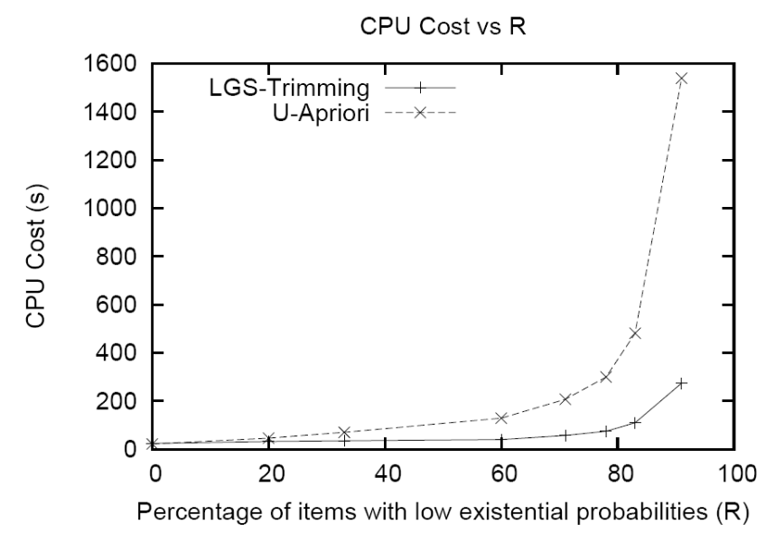
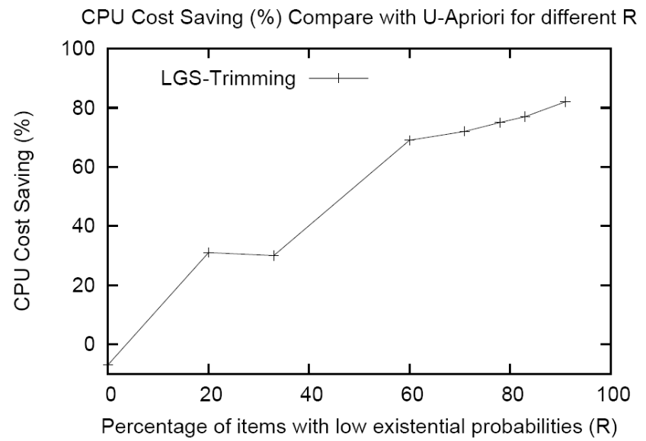
CPU cost with different R
(percentage of items with low probability)
When R increases, more items with low existential probabilities are contained in the dataset, therefore there will be more insignificant support increments in the mining process.
Since the Trimming method has avoided those insignificant support increments, the CPU cost is much smaller than the U-Apriori algrithm.
The Trimming approach achieves positive CPU cost saving when R is over 3%.
When R is too low, fewer low probability items can be trimmed and the saving cannot compensate for the extra computational cost in the patch up module.

Slide 37
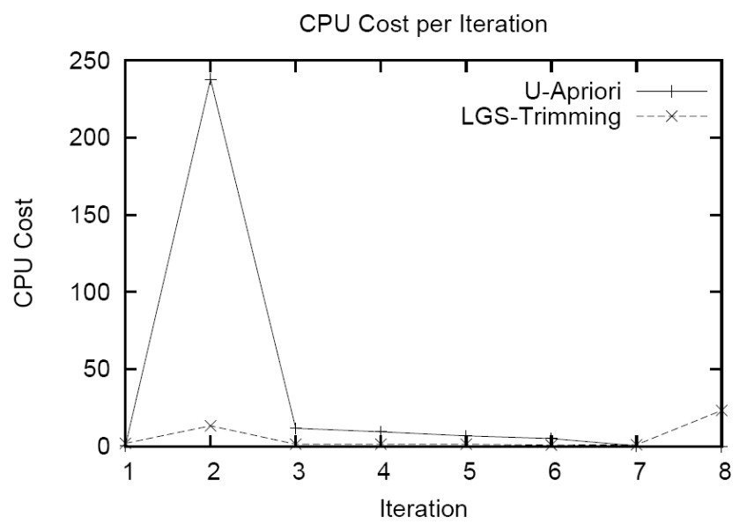
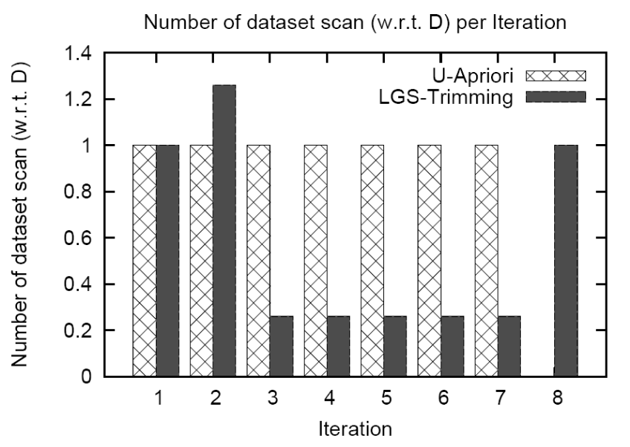
CPU and I/O costs in each iteration (R=60%)
The computational bottleneck of U-Apriori is relieved in the Trimming method.
In the second iteration, extra I/O is needed for the Data Trimming method to create the trimmed dataset.
I/O saving starts from the 3rd iteration onwards.
As U-Apriori iterates k times to discover a size-k frequent itemset, longer frequent itemsets favors the Trimming method and the I/O cost saving will be more significant.
Notice that iteration 8 is the patch up iteration which is the overhead of the Data Trimming method.

Slide 38
Conclusion
We studied the problem of mining frequent itemsets from existential uncertain data.
Introduce the U-Apriori algorithm, which is a modified version of the Apriori algorithm, to work on such datasets.
Identified the computational problem of U-Apriori and proposed a data trimming framework to address this issue.
  The Data Trimming method works well on datasets with high percentage of low probability items and achieves significant savings in terms of CPU and I/O costs.
In the paper …
  Scalability test on the support threshold.
  More discussions on the trimming, pruning and patch up strategies under the data trimming framework.

Slide 39
Thank you!

